Slide 1

Intelligent Inventory Dashboard
Keyloop technical assessment · Scenario B (Supply)
React 19 · Fastify · SQLite · built with directed AI agents
Notes:
I chose Scenario B, the Intelligent Inventory Dashboard: a current view of a dealership's stock that highlights aging vehicles and lets managers record what they plan to do about each one.

Slide 2
Agenda
1
2
3
4
5
Understanding the brief
Architecture
Directing the AI
Test coverage
Live demo
The demo comes last: it proves what the first four parts claim.
Notes:
Agenda: how I understood the brief, the architecture, how I directed and verified the AI, test coverage, and a live demo against the three requirements at the end.

Slide 3




Documented assumptions
1
The data is saved in a real backend
Aging = over 90 days
"Real-time"
15
User stories in the PRD (BA agent)
90 days: no · 91 days: yes · dealership time zone
Refresh every 60 s + manual Refresh
48
Documented assumptions
"Intelligent"
Actions
Transparent rules (KPIs, needs attention), not machine learning
5 statuses + note · append-only · no login
Notes:
The brief is short and ambiguous, so I started with a PRD written by a Business Analyst agent. I asked only one blocking question: where does persistence live? Answer: a real backend. Everything else is a documented assumption, 48 in total. Key ones: aging means strictly more than 90 days in the dealership's time zone; real-time means 60-second refresh plus manual refresh; intelligent means transparent rules, not ML; actions are five statuses plus a note, kept as append-only history.

Slide 4





One shared contract, the server owns the rules
Server computes everything
Age, aging flag, KPIs, filtering, sorting, paging
Web app
API
Database
Injected clock
React 19 · TypeScript
Fastify 5 · Zod
SQLite · append-only
Fixed "today" in tests: 90/91 boundary, Daylight saving time (DST), time zones
Shared Zod contract
one schema validates web + API
Append-only history
No update/delete in the API, blocked by DB triggers too
Refer: https://github.com/huyvk92/keyloop-assignment/blob/main/docs/SYSTEM_DESIGN.md#4-high-level-architecture
Clear error order
400 invalid → 404 not found → 422 not aging; nothing stored
Notes:
React and TypeScript on the front end, Fastify and SQLite on the back end, and one shared Zod contract used by both sides. The server is the single source of business truth: the UI never recomputes a rule. Every date rule reads an injected clock, so tests pin "today" and cover the 90/91 boundary, DST and time zones. History is append-only: no update or delete in the API, and database triggers block them as well. SQLite is durable and zero-ops; moving to Postgres only changes the repository layer.

Slide 5

AI as a team, me as the orchestrator
PRD
TRD
Build in waves
Independent review
Fix round
6 agents with clear roles
I verify every step
Business Analyst
Tech Lead / Architect
Quality gate after every wave
Read critical code: SQL, date maths
Call the real API
Every decision in the AI Collaboration Log
Front End developer
Back End developer
Test engineer
Code reviewer
Notes:
I treated the AI as a team, not an autocomplete: six agents with narrow roles and preloaded best-practice rules, and skills for a spec-driven flow: PRD, TRD, build in waves, independent review, fix round. As orchestrator I ran agents in parallel only on separate files, and I verified every wave myself: the quality gate, reading the critical code, calling the real API and driving a real browser. Every decision and correction is in the AI Collaboration Log.

Slide 6
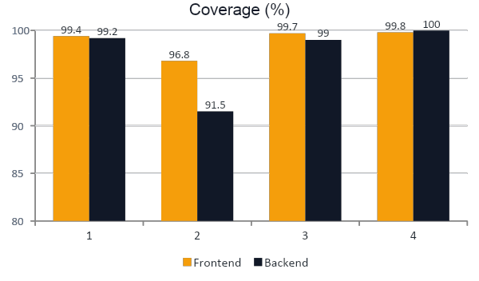
Tested at every layer
824
frontend tests/ Accessibility
369
backend tests
15
end-to-end tests on the real app
Notes:
Every feature was built test-first. Frontend: around 824 tests, about 99 percent coverage. Backend: around 369 tests, about 99 percent. On top of that, 15 Playwright end-to-end tests run against the real API, and CI enforces a minimum coverage threshold. (Show the two HTML coverage reports and read the numbers on screen.) Then: "Now let me show you it working."

Slide 7

Live demo: the three requirements
1 Filter the inventory
2 Spot aging stock
3 Log and keep an action
Make Ford → models narrow
"Over 90 days" → 5 vehicles
Search stk-104
Filters live in the URL
KPIs: 360 · 86 aging · 23.9%
Aging stock: 10 oldest
Range 90–91: 90 no, 91 yes
View → Price Reduction Planned
Needs attention 46 → 45
Reload → still there
90-day car: no form (422)
Extra: Vietnamese UI · Export CSV
Notes:
Requirement 1: choose Ford, the model list narrows; Over 90 days leaves 5 vehicles; search stk-104; filters live in the URL so the view can be shared. Requirement 2: KPIs 360 total, 86 aging, 23.9 percent; the Aging stock section; custom range 90 to 91 shows 90 is not aging and 91 is. Requirement 3: View a vehicle that needs attention, log Price Reduction Planned; the history, row and Needs attention KPI (46 to 45) update without a reload; reload and it is still there; a 90-day vehicle has no form and the server returns 422. Extra: switch to Vietnamese, Export CSV.

Slide 8
I own it because I verified it
AI wrote most of the code · every decision is traceable in docs/
Thank you
Notes:
The AI wrote most of the code, but every requirement, decision and correction is traceable in the docs. I own the result because I verified it, not because I typed it. Thank you.

